Slide 1
Beverage Sales
Analysis and Recommendations for Obaidi Beverage Distributors, Inc.
Group 8:
Meredith, Rafay, Julia, Jessie

Slide 2
Introduction
Dataset Selection
Kaggle dataset: Synthetic Beverage Sales Data.
Transaction style records including Customer, Product, Category, Region, Quantity, Unit Price, Discount, and Order Date.
8.9 Million records from 2021-2023.
Data Wrangling
Filtered to just include 2023 records (approximately 2.9 million) for analysis.
Cleaned column names and standardized data types.
Removed invalid or null records.
Expanded time components (Month, Year, Weekday/Weekend) to support trend analysis
Prepared the dataset for SQL querying and dimensional modeling.
Goal: Understand demand, pricing behavior, discount strategy, and customer patterns to uncover actionable insights.
Notes:
Slides 1-2: 1 minute

Slide 3
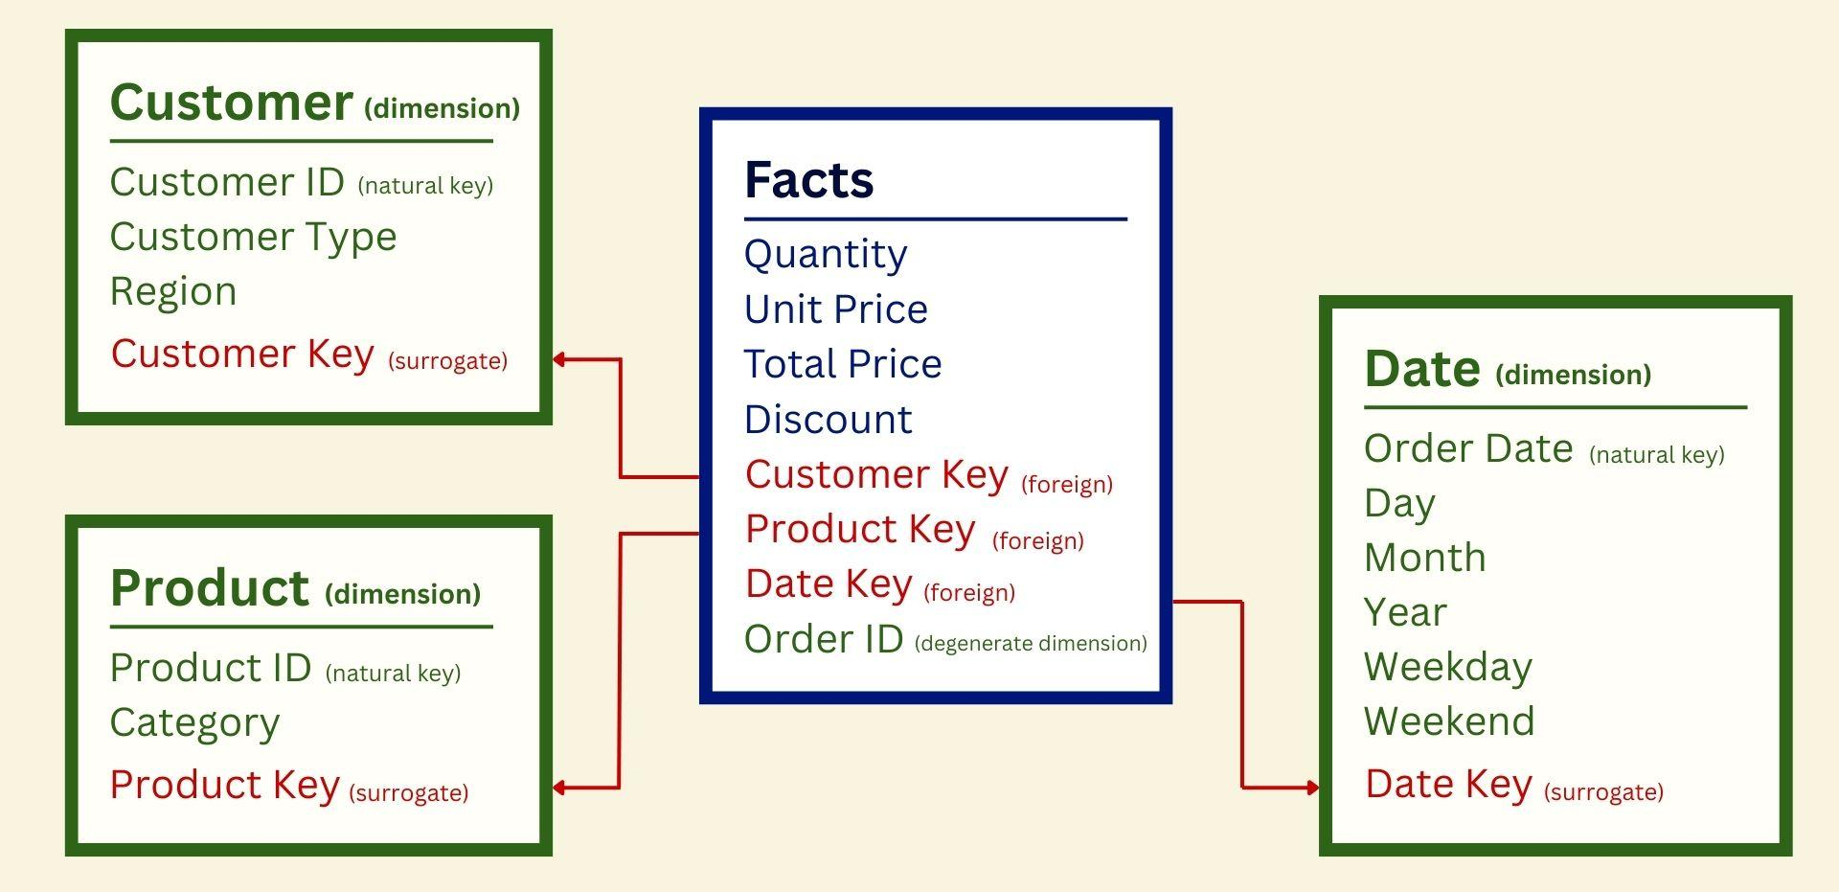
Dimensional Model

Slide 4
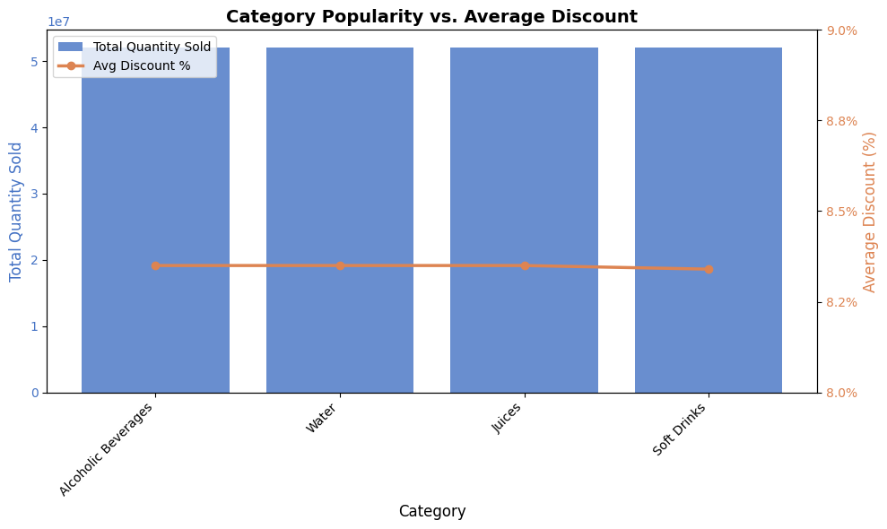
Which of the categories are most popular, and are any of those being discounted?
The 4 most popular beverage categories sell in nearly identical volumes, the average discount rates are also almost identical across categories.
Indicates a uniform non-targeted discount strategy. → Opportunity to adjust discounts by category to improve margins for strong performers that don’t need incentives.

Slide 5
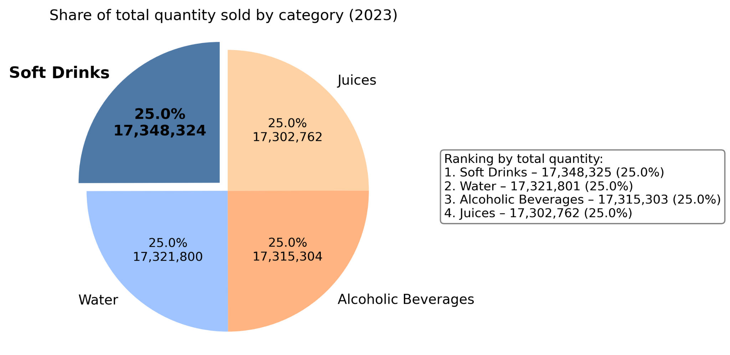
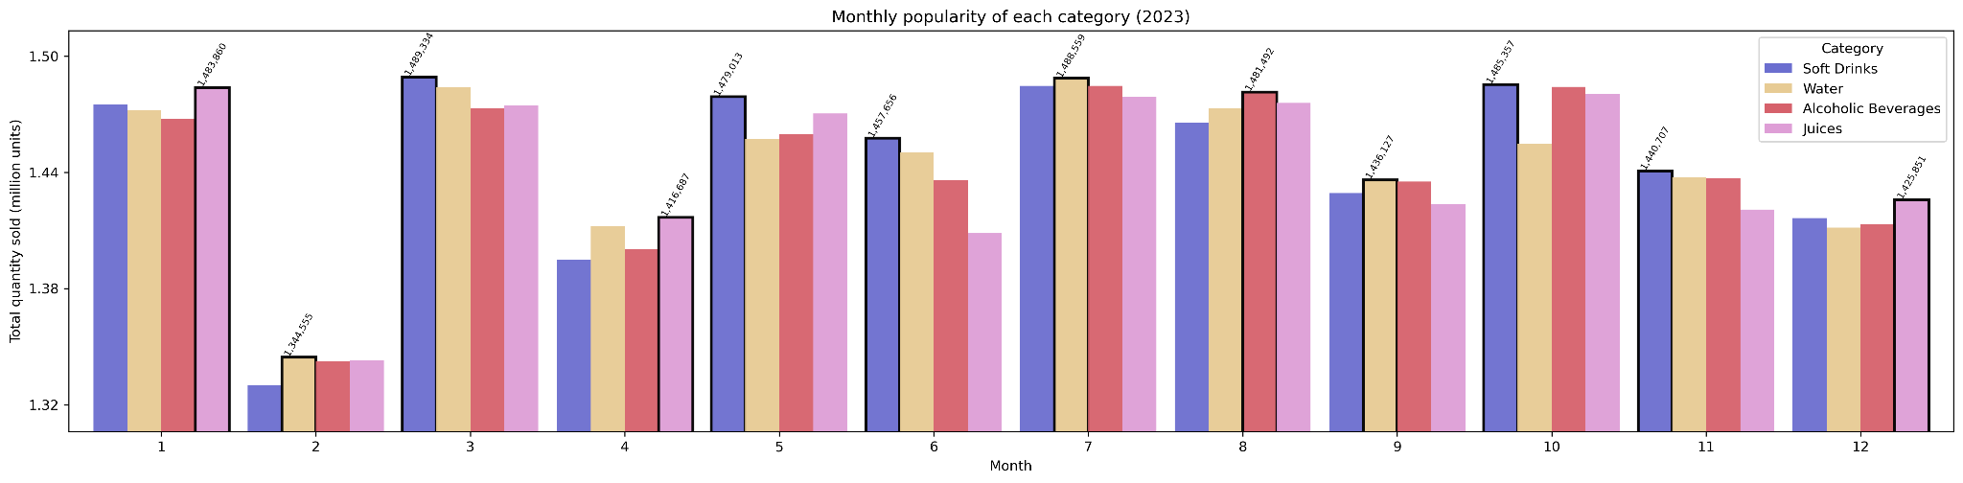
How does the popularity of each category change by month? Are there clear seasonal peaks?
Soft drinks most frequently rank first.
Alcoholic beverages show increase in ranking in Aug-Oct.

Slide 6
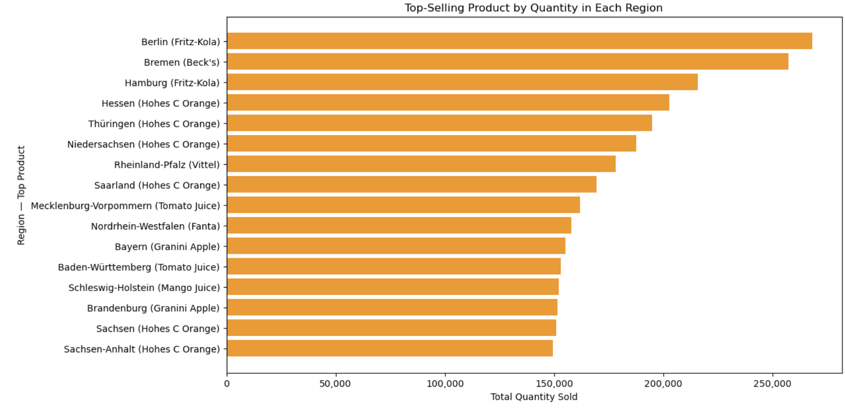
Which product is the top-seller in each region?
Hohes C Orange is the most popular product by quantity in six regions. Fritz-Kola dominates in two regions—Berlin and Hamburg. Berlin, being a major city, has the highest sales volume at approximately 268,308 units.
Consider implementing a region-based product strategy rather than a uniform national approach, given the diverse demand patterns across regions. Promotions should be tailored to product popularity in each region, which can increase sales and improve overall revenue.

Slide 7
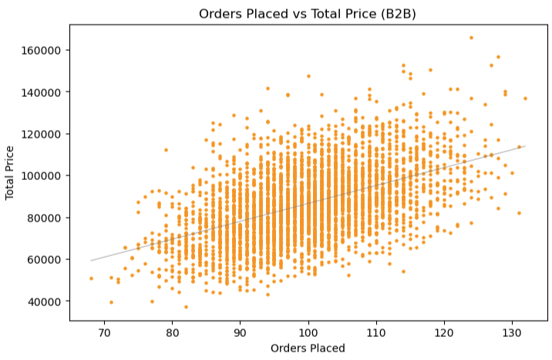
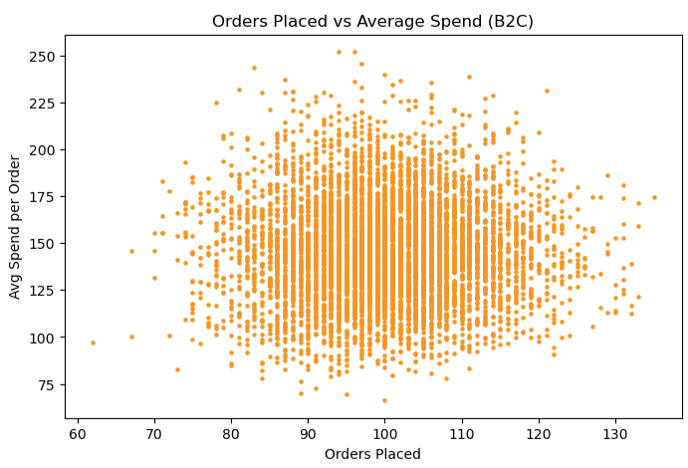
Are larger orders from repeat customers?
How does this compare between the customer types?
All customers are repeat (>1 order per week) - cannot distinguish between repeat or one-time customers.
Looked for correlation between the size of the sale and the frequency with which the customers return.
Strong correlation between total spend and the number of orders placed, but spend accumulated.
When calculating the average spend per order, really no correlation between how much the most frequent customers spend.
The only insight we can provide Obaidi Beverage Distributors from this inquiry is that they have very loyal customers, and may want to consider a loyalty program to increase order frequency, or a discount off of larger orders to increase spend per order.
Notes:
All of the customers represented in the dataset were repeat customers.
The lowest number of orders among B2B customers in 2023 placed 68 orders over the year, among B2C this number was 62 - both are more than an order each week, so there was no distinguishing between repeat or one-time customers.
I decided to see if there was any correlation between the size of the sale and the frequency with which the customers return.
I only included one scatter plot from each customer type here because they were nearly identical! With each customer type, you can see that there was strong correlation between total spend and the number of orders placed - a total “duh” moment for me! When I calculated the average spend per order, you can see that there is really no correlation between how much the most frequent customers spend.
The only insight we can provide Obaidi Beverage Distributors from this query is that they have very loyal customers, and may want to consider a loyalty program or discount off of larger orders if increasing the spend per order is desired.

Slide 8
Limitations
Warehousing & Inventory
Customer Details
Manufactured Data
Data only included customer location, not origin of order to be distributed or distance product must travel. With this information, insights could be sought for cost savings.
Understanding the industries of B2B customers, or the settings (urban, rural) of B2C customers could provide insights for marketing spend.
Manufactured data is very clean with round numbers and consistent, uniform proportions. Organic data may result in more variation and better actionable insights.

Slide 9
Business Insights
Seasonal Lift
Regional Strategy
Pricing Opportunity
Determine cause of seasonal increase in alcoholic beverages Aug - Oct, replicate conditions in other seasons or with other product categories.
Tailor various promotion strategies for each region based on the popularity of various products in each region to increase sales and revenue.
Decrease discounts among more popular products for a limited time to determine impact on sales volume, or increase discount on less popular products.

